Slide 1
Visualizing Water Data

Slide 2
werusys industry office
Cologne, Germany
Chemical industry
Production monitoring + controlling
Energy monitoring + controlling

Slide 3
Hackathon
Visualize time-based grid state
Problem detection
Problem flow through net
Predictive maintenance
Customizable additional data, e.g. consumption, temperature
Technology
PI AF
PI Web API
Open Street Map
Infragistics (Trial / Free Version)

Slide 4
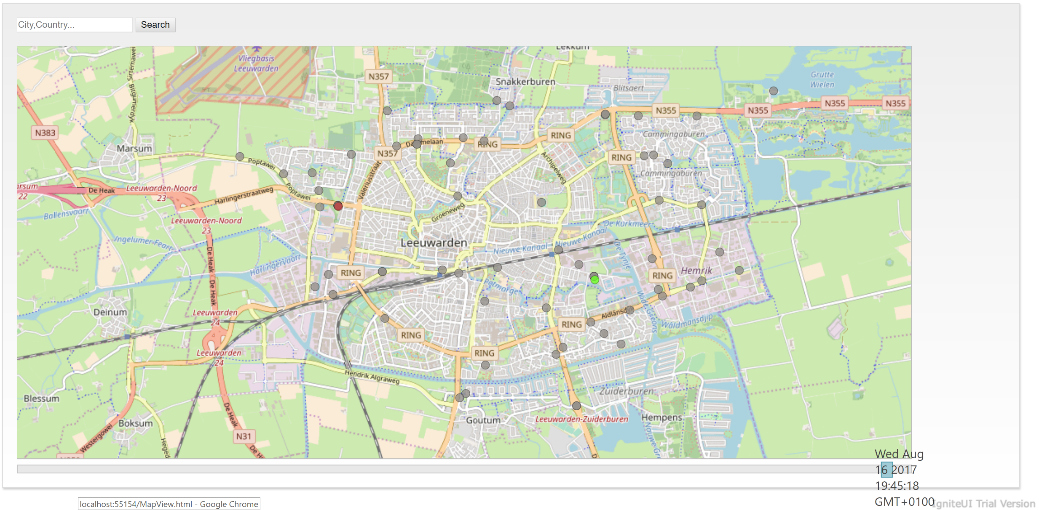

Slide 5
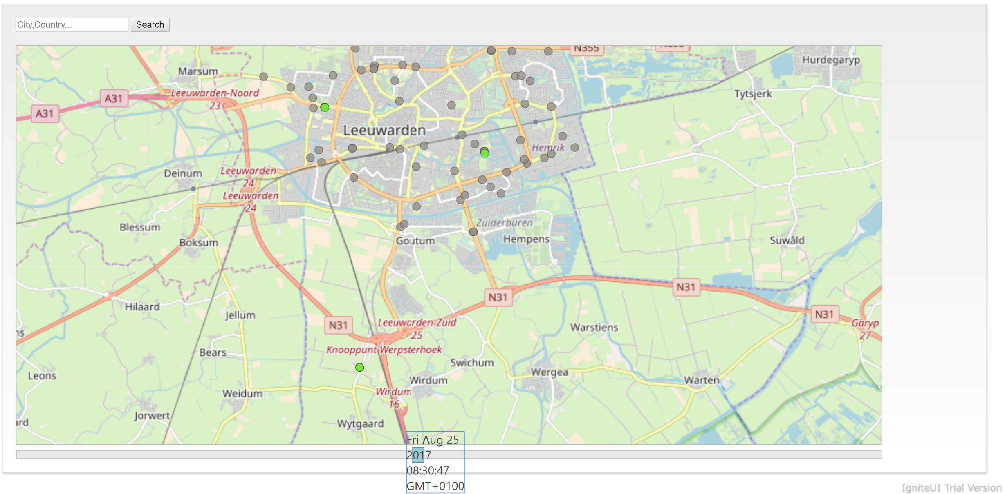

Slide 6
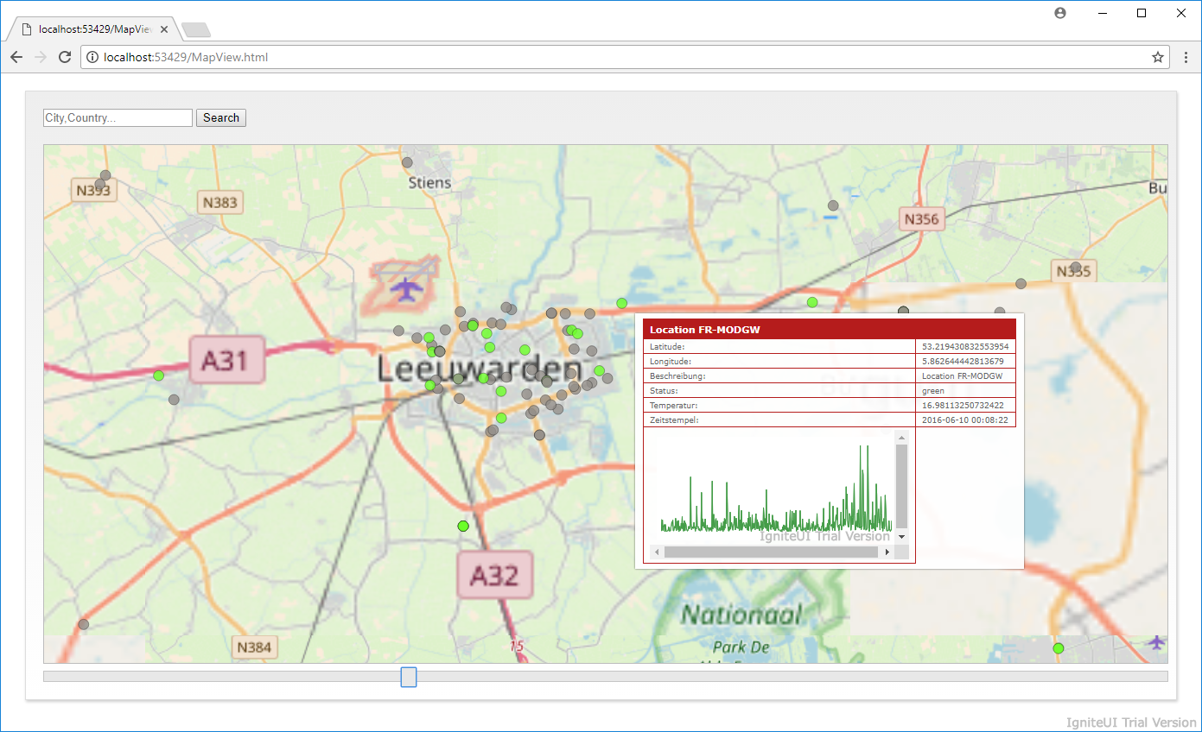

Slide 7
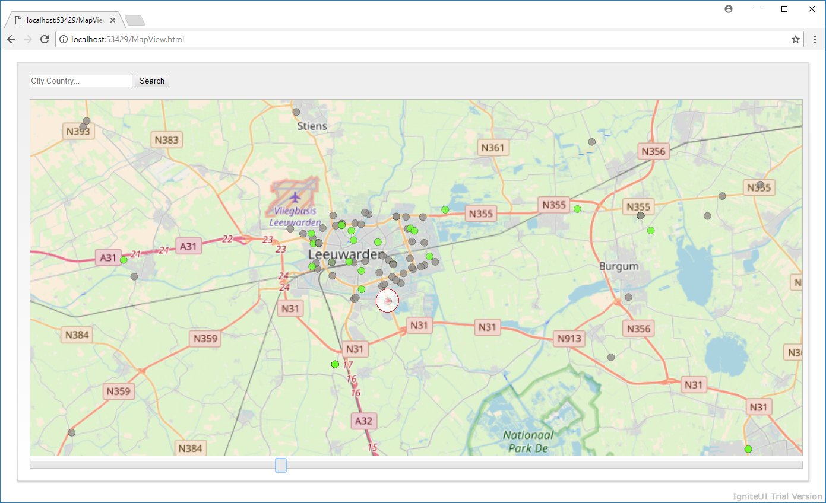

Slide 8
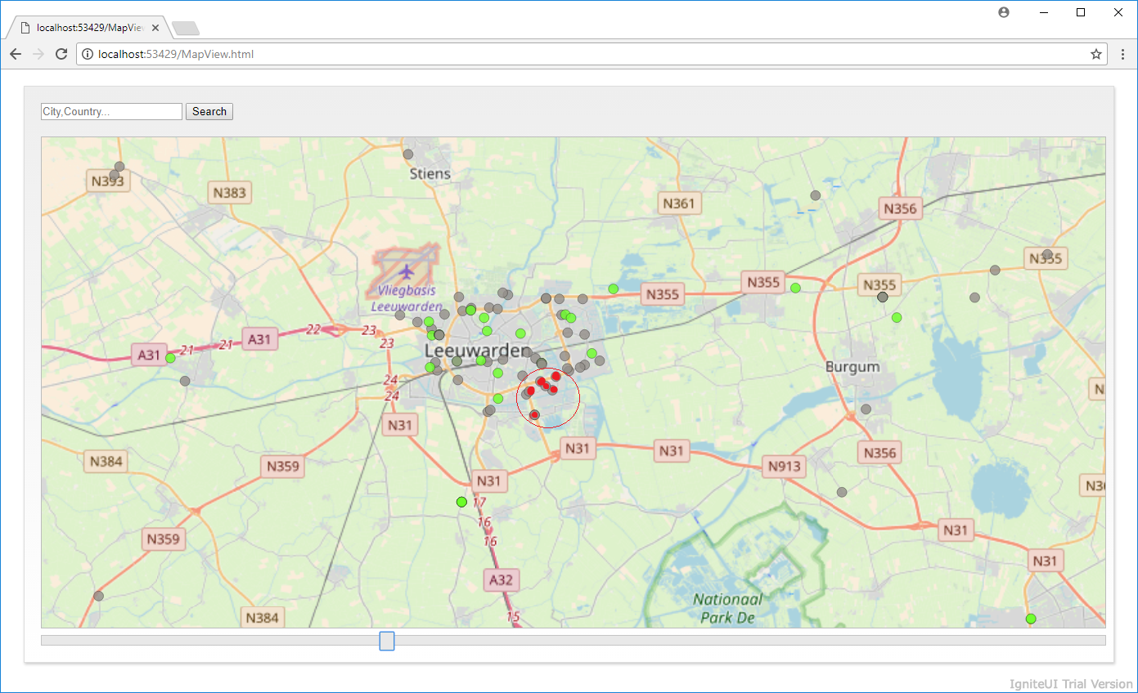

Slide 9
Questions?
Thank you for an excellent Hackathon!
Team werusys Cologne:
Ansgar Backhaus
Mathias Pawlak
Julian Weber
www.werusys.de

